Slide 1

BSTA 478 – FINAL PROJECT PRESENTED TO KRZYSZTOF DZIECIOLOWSKI
Submitted By Team Rose
Yina Li 40098442
Kevin Heng 40055424
Mohammad Feras Anbari 40074495
Ming Xuan Wu 40077164
Notes:
***THIS SLIDE IS HIDDEN AND WILL NOT BE SHOWN DURING THE DIAPORAMA VIEW***
BSTA 478 – Final Project Presented to Krzysztof Dzieciolowski
Submitted By Team Rose
Yina Li 40098442
Kevin Heng 40055424
Mohammad Feras Anbari 40074495
Ming Xuan Wu 40077164

Slide 2

BANK CHURNING RATE
Team Rose

Slide 3
AGENDA
Context
Business Problem
Scope
Literature Reviews
Model Selection
Decision Tree
Neural Network
Gradient Boosting
Random Forest
Logit
Ensemble Model
Appendix
Contributions
SAS EM Diagram
References
Methodology
Variable Selection
Data Distribution
Data Cleaning
Variable Transformation
Standardization
Results & Conclusion
Best Model
Conclusion
Recommendation
Q&A

Slide 4

CONTEXT

Slide 5
BUSINESS PROBLEM
What is Churn Rate?
“Churn Rate measures the rate at which business loses customers or subscribers within a specific time period”
Notes:
Churn Rate definition: https://www.oberlo.com/ecommerce-wiki/churn-rate

Slide 6

SCOPE OF THE PROJECT
Dataset from Kaggle.com;
Sample of 10 000 observations;
21 features;
Baby Boomers characteristics;
Model to predict whether or not a customer would close their bank account (i.e. Churn) or not.

Slide 7
LITERATURE REVIEWS
Braun & Schweidel (2011) studied customer retention and churning rate. They created a model and applied it to a telecommunication provider. Our sample shares many variables with their study, such as the income, the age, the education level, and whether or not the customer has dependents (such as kids) or not.
In a different literature, Lemmens & Croux (2006) also studied the churning rate of an anonymous telecommunication provider. In their paper, they explained their methodology, such as how they partionned the data and how they excluded variables with more than 30% missing values. Our sample also shares many variables with their study, such as account spending limit, marital status, and duration of how long the customer has been doing business with the company.
Burez & Van den Poel (2009) highlights methodologies to resolve unbalanced classes issues in churn prediction. Our target class ATTRITION_FLAG has an unbalanced churn-to-no churn ratio, thus our model may become overfitted. The literature suggests using weighted random forest classifiers and Gradient Boosting. It allows to assign weight to the class variable and thus penalize those that contribute significantly to the model misclassification. As a result, our model is able to learn with an unbalanced dataset.

Slide 8
LITERATURE REVIEWS
Miktees, M Badr, and ElSeddawy (2022) built a model that will predict churned customers through defining the customer's precise behaviors and attributes. They used data mining techniques such as clustering for detection, classification for prediction and association rule for detection. Our business problem and theirs are very similar, and these researchers have seen success in their model.
Kumar & Ravi (2008) developed an ensemble model combining Multilayer Perceptron, Logistic Regression, Decision Trees, Random Forests, Radial Basis Function Network, and Support Vector Machine to solve a customer credit card churn prediction problem. The paper outlines that the dataset used for this study is highly unbalanced and required the employment of undersampling and oversampling and the Synthetic Minority Oversampling technique to bring it to a balance. Considering that our dataset is unbalanced to an extent, applying these methods can assist in balancing it back which ultimately leads to having a strong model with valid predictions.

Slide 9
LITERATURE REVIEWS
Lu, J. (2002) perform a survival analysis using SAS to effectively evaluate a telecommunication company churn rate over time. The authors highlight issue that he had to perform on the dataset. Variable transformation to reduce skewness level in the variables, filtering extreme outliers and inputting for incomplete dataset. This article importance lies in its exploratory data analysis phase methodologies and its utilization of lift to evaluate the churn rate at each deciles.
Silva, C. & Ramos, B. S. (2020) performed a pemilary segmentation on the financial institution churned customer using K-Means algorithm with SAS EM. Subsequently, they could segmented their predictives models (Decision Tree, Logistics, Random Forest) according to their found clusters. Thereby, they could better classify the churned population.
Peravalli, K. & Dr. Khots, D. (2017) analyzed the churn rate in a B2B setting to predict the optimal churn model. The authors assessed the performance of different models with SAS EM such as Decision Tree, Logistics Regression and Neural Network using the KS criteria. Lastly, they used the Cumulative Lift Chart to evaluate the decile that contributed the most to the churn. Thus, they could better target these particulars customers.

Slide 10

METHODOLOGY

Slide 11
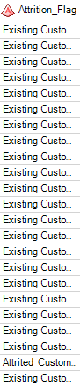
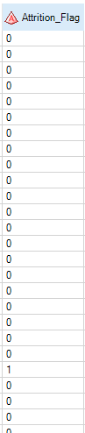
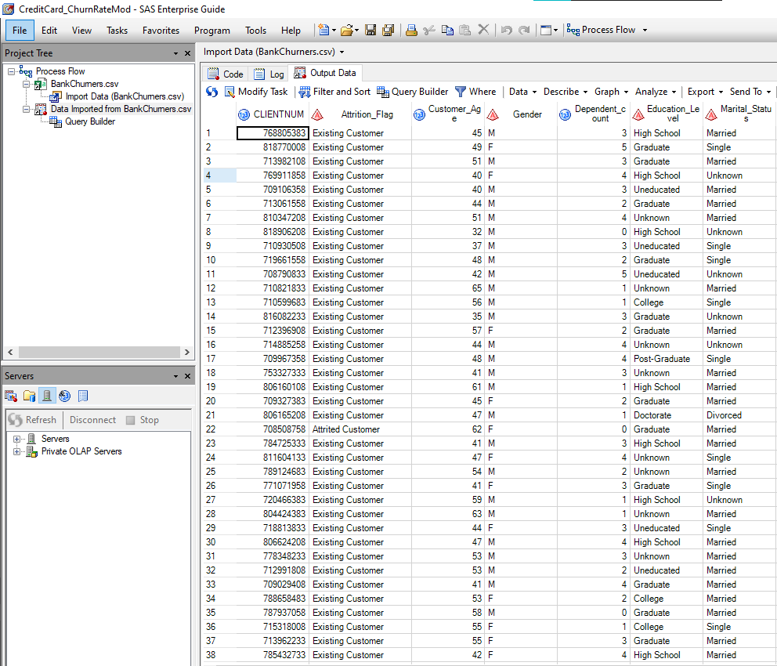
CHANGES TO VARIABLE (SAS EG)
Attrition Flag level modified to binary using SAS EG Query Builder:
Modify Existing Customer to 0 and Attrited customer to 1

Slide 12

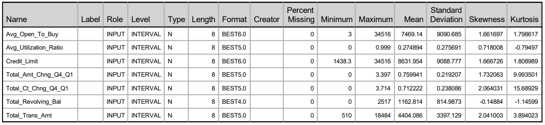
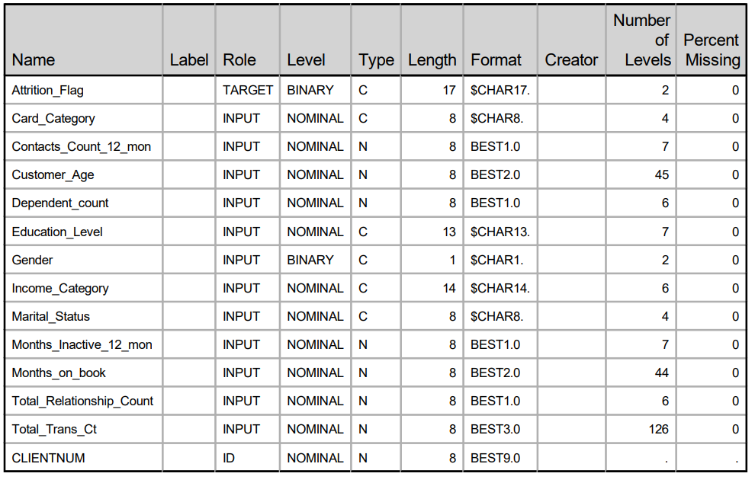
VARIABLE SELECTION
7 Interval Variables
12 Nominal Variables
2 Binary Variables

Slide 13
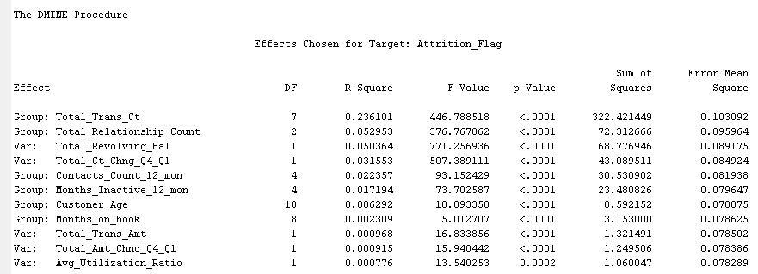
SIGNIFICANT VARIABLES TO THE MODEL
Insignificant Variables have been dropped using variable selection and only the ones that add value to the model remain.
Complexity Reduced

Slide 14
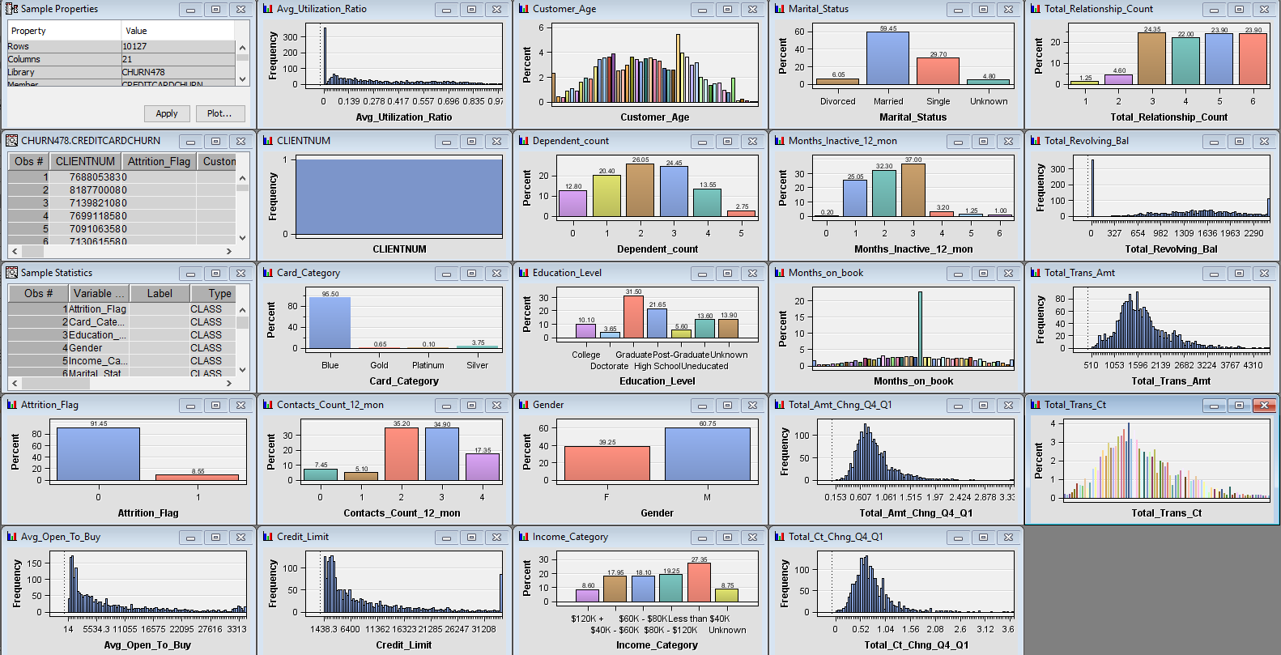
DATA DISTRIBUTION
Notes:
After exploring our variables, we notice that most of the distributions of the variables are not normal or linear, and to fix that we need to do variable transformation and standardization. Also, we notice that the target variable, Attrition Flag, is unbalanced.

Slide 15

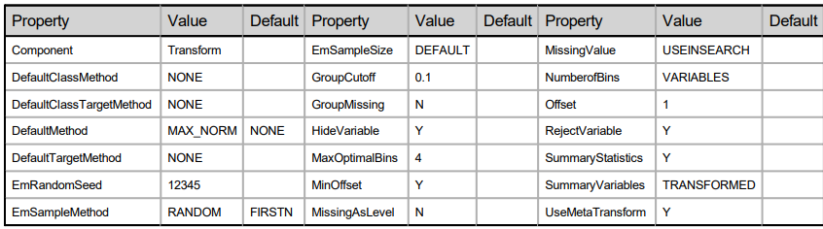
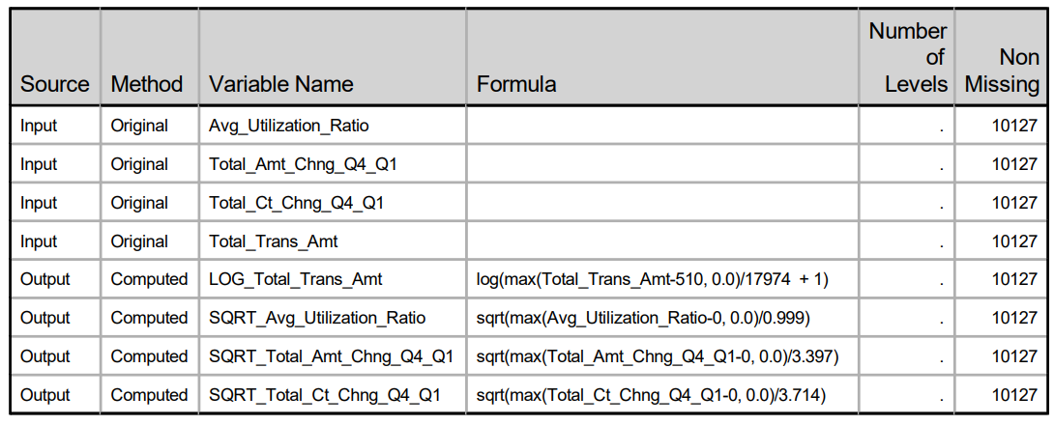
DATA CLEANING – VARIABLE TRANSFORMATION
Stabilized Variance
Corrected non-normality
Removed non-linearity
Generally improved the fit of the model to the data

Slide 16

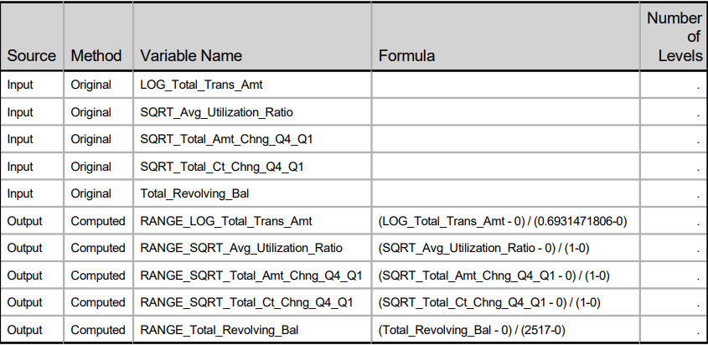
DATA CLEANING – VARIABLE STANDARDIZATION
Performs weighted standardization
Stabilizes the data so that the variables are measured at one scale
If not standardized:
Numerical stability and precision of estimators are influenced

Slide 17

MODEL SELECTION

Slide 18
MODEL SELECTION
Decision Tree
Neural Network
Random Forest
Gradient Boosting
Logit
Ensemble

Slide 19
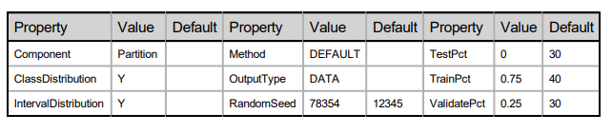
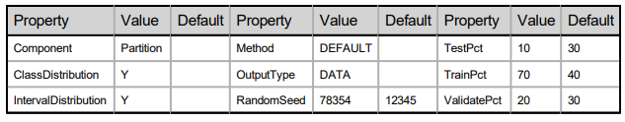
PARTITION
Logit
Decision Tree| Neural Network |
Random Forest | Gradient Boosting | Ensemble

Slide 20
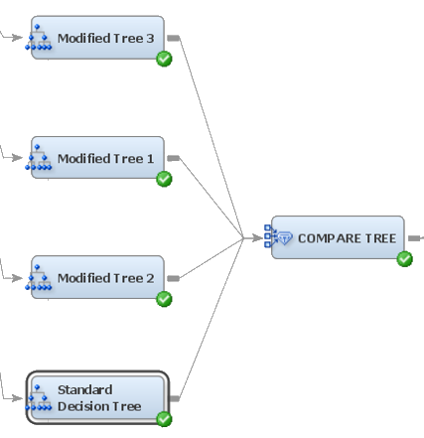
DECISION TREE
We use Standard Decision Tree and Modified Decision Trees because we can modify Interval, Nominal, and Ordinal Target Criterions, Maximum Branch and Maximum Depth.
Interval, Nominal, and Ordinal Target Criterions: Specify the method that you want to use to evaluate candidate splitting rules for interval, nominal, and ordinal variables, respectively, and to search for the best one.
Maximum Branch: Branch required for splitting rule.
Maximum Depth: Depth required for splitting rule.

Slide 21
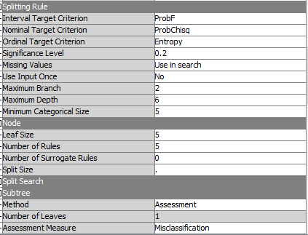
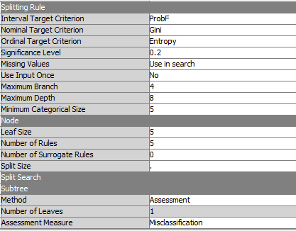



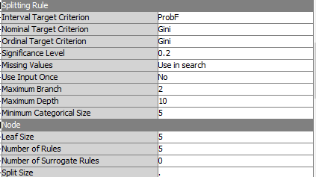
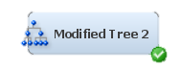

DECISION TREE

Slide 22
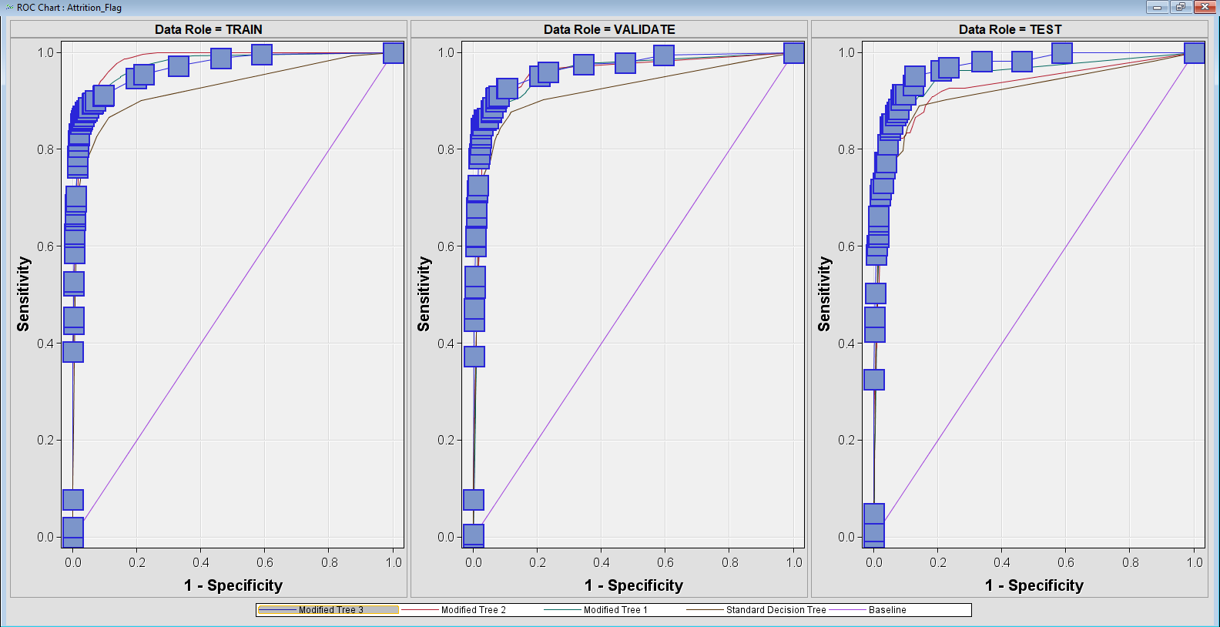
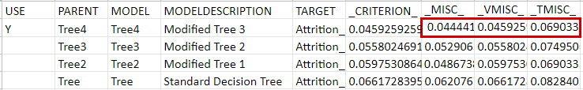
DECISION TREE – COMPARISON
Our best setting: Modified Tree 3
Interval Target: ProbF
Nominal Target: Gini
Ordinal Target: Gini
Max Branch: 2 | Max Depth: 10
_MISC_ : Difference between train(0.044441), validation(0.045925) and test(0.069033):
_MISC_ is within the significance 0.05.
The best Decision Tree is not overfitted.

Slide 23
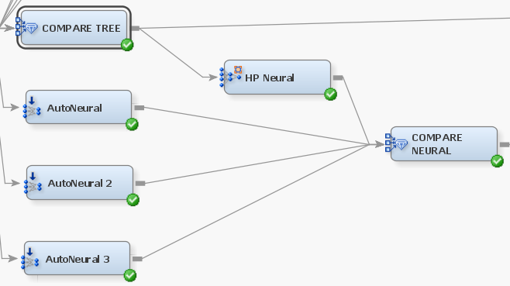
NEURAL NETWORK
We use AUTONEURAL and HP NEURAL because we can modify neuron, hidden layer and access to advanced multilayer architecture; these features are missing in the standard Neural Network node.
Architecture:
Single-Layer add significant neurons to the model one at a time.
Block-Layer add homogeneous neurons as new hidden layer to the model.
Hidden Unit: Affect run-time if in excess
Maximum iteration: Affect run-time and can lead to overfitting if run past an user-defined threshold.

Slide 24
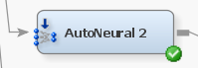
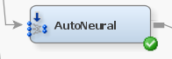
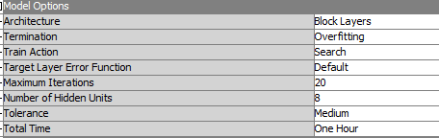
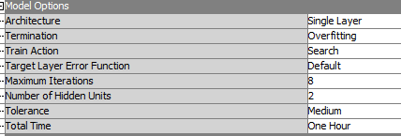
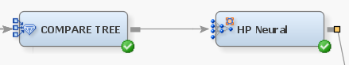
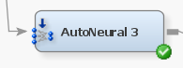
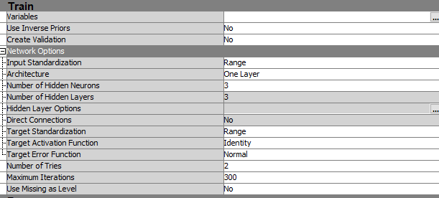
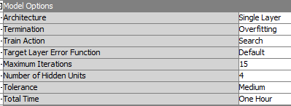
NEURAL NETWORK

Slide 25
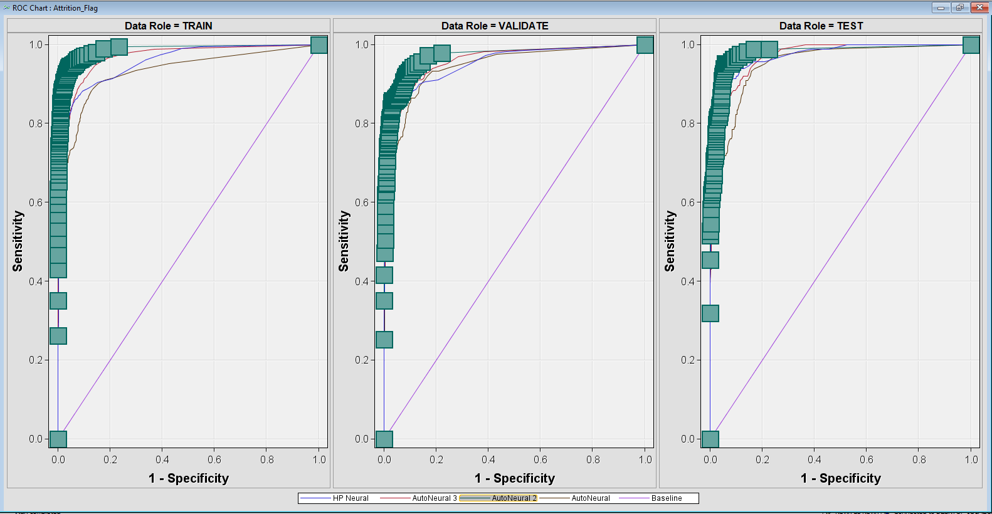
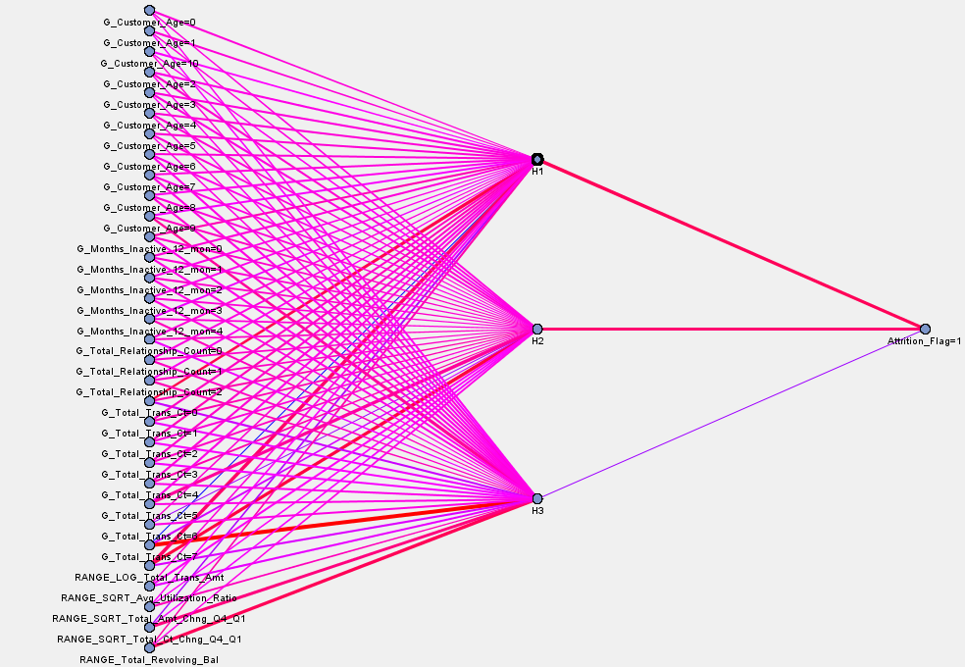
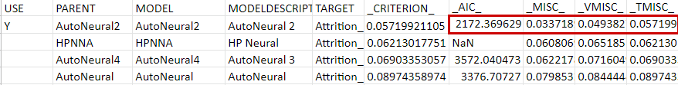
NEURAL NETWORK – COMPARISON
Our best setting: Max iteration: 20,
Max hidden unit: 8,
Block-layer architecture.
_MISC_ : Difference between train(0.03371), validation(0.049382) and test (0.057199) _MISC_ is within the significance 0.05. The best neural network is not overfitted

Slide 26
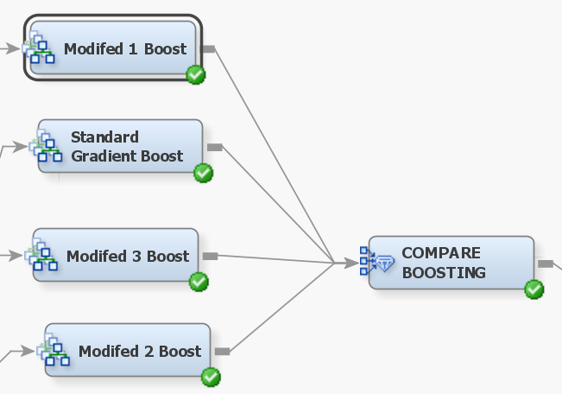
GRADIENT BOOSTING
Gradient Boosting: Model is based on merging each iteration that has low deviation error.
We modify the Huber M-Regression, Maximum Branch and Maximum depth.
Huber M-Regression: Between 0.6 to 1, it is a robust loss function (error function for modeling) for target variable that is unbalanced. SAS recommend 0.9 for unbalanced target variable.
Maximum Branch: Branch required for splitting rule (similar to Decision Tree split)
Maximum Depth: Depth required for splitting rule (similar to Decision Tree split)
Maximum Branch and Maximum Depth affect the gradient boosting performance.

Slide 27
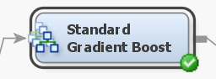
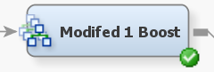
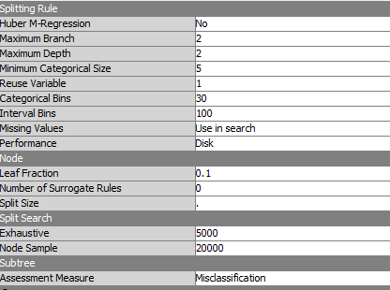
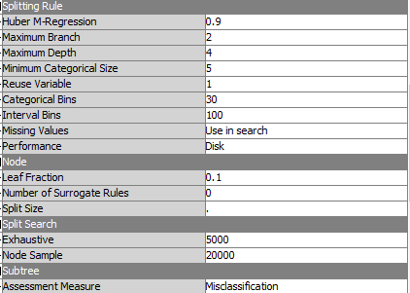
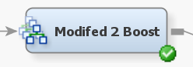
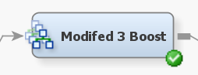
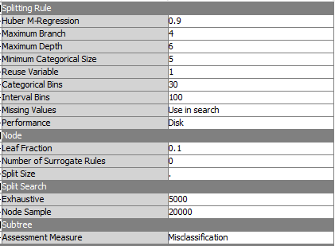

GRADIENT BOOSTING

Slide 28
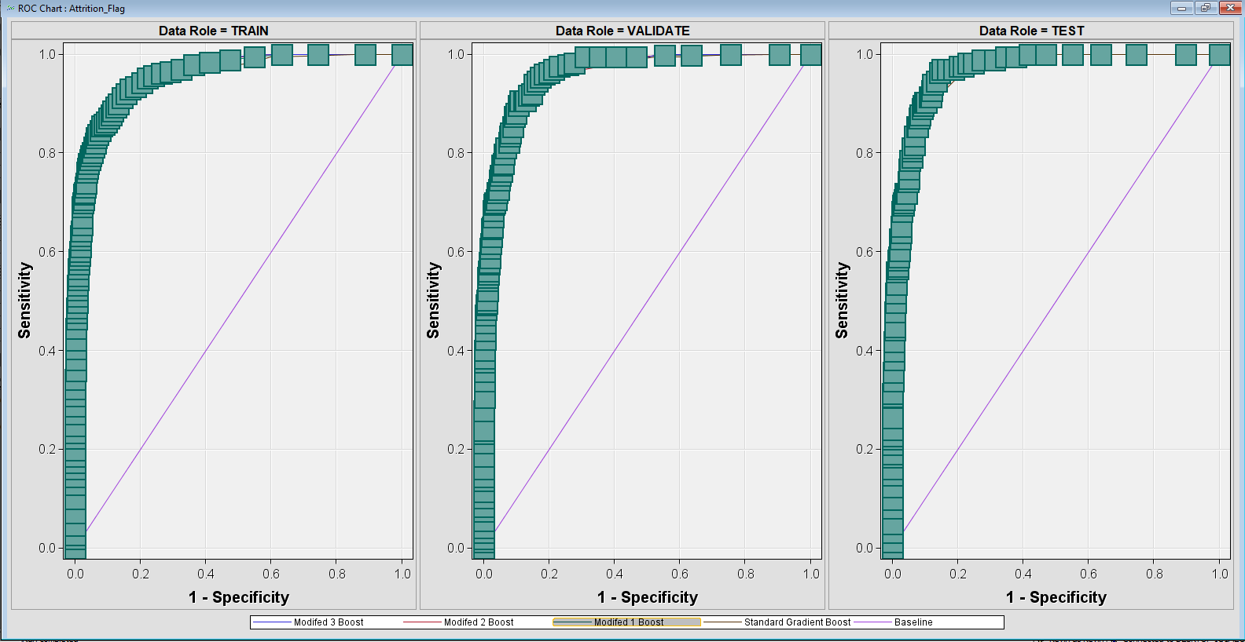
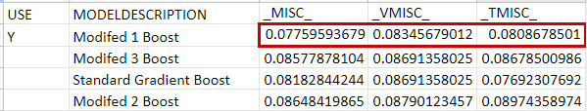
GRADIENT BOOSTING – COMPARISON
Our best setting: Huber M-Regression: 0.90, Max Branch 2, Max Depth 4
_MISC_ : Difference between train(0.07759), validation(0.08345) and test (0.08876) _MISC_ is within the significance 0.05.
The best gradient boosting is not overfitted.

Slide 29
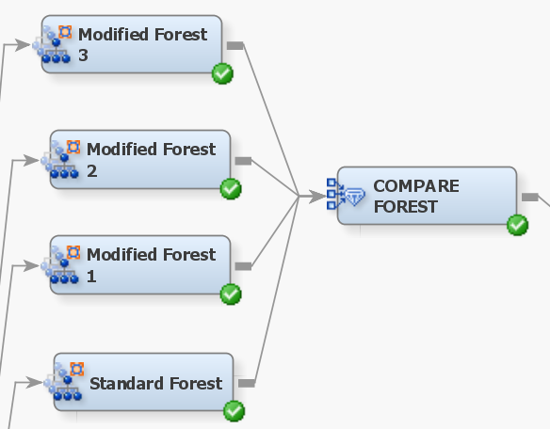
RANDOM FOREST
Random Forest: Ensemble of decision tree that is weighted based on uneven class level variables.
We modify the Maximum Tree and Leaf size method.
We did not modify the Maximum Depth beyond 50, due to an encounter with RUN-TIME ERROR
Maximum Leaf Size method should remain at default. At default, the node automatically picks the best one.
You can force to use Count (nbs observation) or Proportion (% observation)
Maximum Tree affects the forest performance. HP FOREST will always double this amount.

Slide 30
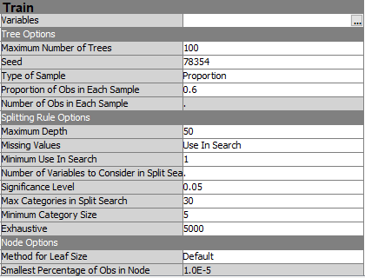
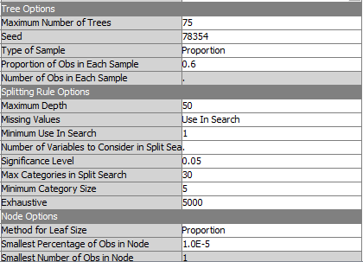
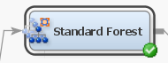
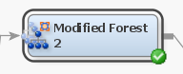
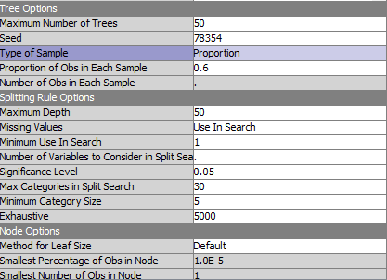
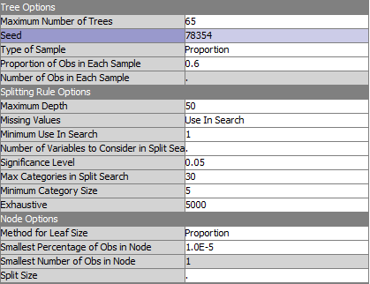
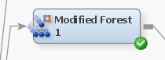
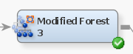
RANDOM FOREST

Slide 31


RANDOM FOREST – COMPARISON
Our best setting: Max 50 tree | Max depth: 50 default | Leaf size method: default
_MISC_ : Difference between train(0.0502), validation(0.06567) and test (0.058185) _MISC_ is within the significance 0.05.
The best random forest model is not overfitted.

Slide 32


LOGIT
All models criterions are identical due to the fact that all variables are significant in the model
The MODEL_COMPARISON node selected the full logit model as the best-fit model.
Logit Model Comparison

Slide 33


AGGREGATE: ENSEMBLE MODEL
Tree-based Ensemble Model with Gradient Boosting Model, Decision-Tree Model, Neural Network Model, and Logit Model
Average for predicted values and class targets

Slide 34

RESULT & CONCLUSION

Slide 35




BEST MODEL – MISCLASSIFICATION RATE
Model Comparison
Notes:
These models are ranked based on the misclassification rate.

Slide 36

BEST MODEL – MISCLASSIFICATION RATE
Notes:
Roc curve figures, the Modified Tree 3 (AUC=0.967) is selected. The AUC is low compared to the other models.

Slide 37



BEST MODEL – ROC
Model Comparison
Notes:
These models are ranked based on the ROC index.

Slide 38

BEST MODEL – ROC
Notes:
Roc curve figures, the Ensemble model (AUC = 0.985) is selected. The AUC is highest compared to the other models.

Slide 39

CONCLUSION
Benefits of Ensemble models:
1. Ensemble methods have better predictive accuracy than individual models
2. Ensemble models reduce underfitting/overfitting most of the time
3. Ensemble models have less noise and more stability

Slide 40

CONCLUSION
Our best model is the Ensemble model, but the decision tree was also a very good model!
Benefits of the decision-trees:
Decision tree are useful for mimicking human decision-making
Decision trees are highly scalable, they can predict a large number of data
Simplified Decision Tree Example:

Slide 41

RECOMMENDATION
After doing variable exploration, we noticed that our target market was skewed due to the older population in our dataset, which causes our target variable: Attrition flag, to be unbalanced.
If the company wants to have a more balanced and representative churn rate, they should also include the younger population in their target market, since older customer will likely stick to a bank, and have no strong interest to change banks. Thus, the older customer churn rate would be lower than the younger customer population.

Slide 42

Q&A

Slide 43
APPENDIX

Slide 44

SAS EM DIAGRAM

Slide 45
CONTRIBUTIONS
Yina Li 40098442: Contribution percentage: 100%
She analyzed the Logistic Regression models.
She proposed on the project conclusion and its alternative proposal for the business problem.
She analyzed the Neural Network models, and ran their required nodes.
Kevin Heng 40055424: Contribution percentage: 100%
He analyzed the Gradient Boosting models, and ran their required nodes.
He presented the analysis of Neural Network, Gradient Boosting, and Random Forest models.
He assisted to any bug issues encounter in SAS EM, and ran Logistic Regression models nodes.
Mohammad Feras Anbari 40074495: Contribution percentage: 100%
He analyzed the dataset variables characteristics and distributions, and on the Decision Tree models.
He ran the required nodes for the Decision Tree models
He presented on variable distribution and characteristic, variable transformation and standardization, and Decision Tree.
Ming Xuan Wu 40077164: Contribution percentage: 100%
He edited the presentation Powerpoint and assemble all the analysis together.
He analyzed the Random Forest models, and ran their required nodes.
He present Project Scope, Business Problem and the dataset variables.
Team Effort:
We explored, cleaned, and performed any necessary transformation / standardization on the dataset.

Slide 46
REFERENCES
Braun, M., & Schweidel, D. A. (2011). Modeling Customer Lifetimes with Multiple Causes of Churn. Marketing Science, 30(5), 881–902. http://www.jstor.org/stable/23011984
Burez, J., & Van den Poel, D. (2009). Handling class imbalance in customer churn prediction. Expert Systems with Applications, 36(3), 4626–4636. https://doi-org.lib-ezproxy.concordia.ca/10.1016/j.eswa.2008.05.027
Goyal, S. (20202, November). Credit Card customers: Predict Churning customers, Version 1. Retrieved March 19, 2022 from https://www.kaggle.com/rtatman/r-vs-python-the-kitchen-gadget-test
Kumar, D. A., & Ravi, V. (2008). Predicting credit card customer churn in banks using data mining. International Journal of Data Analysis Techniques and Strategies, 1(1), 4. https://doi.org/10.1504/ijdats.2008.020020
Lemmens, A., & Croux, C. (2006). Bagging and Boosting Classification Trees to Predict Churn. Journal of Marketing Research, 43(2), 276–286. http://www.jstor.org/stable/30163394
Lu, J. (2002).Predicting Customer Churn in the Telecommunications Industry –– An Application of Survival Analysis Modeling Using SAS. SAS Conference Proceedings: SAS Users Group International 27. https://support.sas.com/resources/papers/proceedings/proceedings/sugi27/p114-27.pdf

Slide 47
REFERENCES
Miktees, M Badr, and ElSeddawy (2022). Customer Churn Prediction Model Using Data Mining Techniques.
Research Gate, DOI:10.1109/ICENCO.2017.8289798
https://www.researchgate.net/publication/323135664_Customer_churn_prediction_model_using_data_mining_techniques
Peravalli, K. & Dr. Khots, D. (2017). Churn Prevention in Telecom Services Industry- A systematic approach to prevent
B2B churn using SAS . SAS Global Forum 2017. https://support.sas.com/resources/papers/proceedings17/1414-2017.pdf
Silva, C. & Ramos, B. S. (2020). Relationship analysis and customer churn forecasting in a financial cooperative institution.
SAS Global Forum 2020. https://www.sas.com/content/dam/SAS/support/en/sas-global-forum-proceedings/2020/5043-2020.pdf

